Slide 1

ADITYA ENGINEERING COLLEGE(A)
Multimodal Medical Image Fusion Using Discrete Wavelet Transform (DWT) with Non-subsampled Contourlet Transform (NSCT) Hybrid Fusion Algorithm
Batch-D3
V.SATYANARAYANA
Associate Professor & Head
Department of Electronics and Communication Engineering
Aditya Engineering College (A)
Email: hod_ece2@aec.edu.in
KUDIPUDI MADHURI(17A91A04K3)
RAMA KRISHNA ROHITH KANKATALA(17A91A04M0)
3. PACHCHIPALA SRI VEERENDRA (18A95A0447)
BIRUDA SANTHOSHI SARANYA(17A91A04I1)
5. MANDAPALLI MANOJ KUMAR(17A91A04K8)

Slide 2
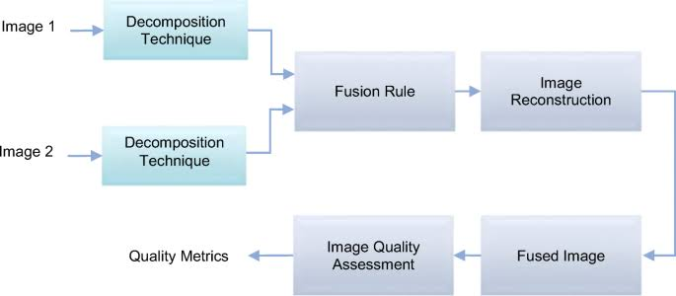
Aditya Engineering College(A)
Introduction:
The Image Fusion process is defined as gathering all the important information from multiple images, and their inclusion into fewer images, usually a single one. This single image is more informative and accurate than any single source image, and it consists of all the necessary information.
In this image fusion process we use two different techniques i.e.. Discrete Wavelet Transform (DWT)with Non-Subsampled Contourlet Transform(NSCT).

Slide 3
Aditya Engineering College(A)
Existing Methods:
Anatomic imaging technologies like MRI and CT clearly show the morphological features like size and shape, but no information on proliferation or inflammation are provided.
The PCA & DCT are conventional fusion techniques with many drawbacks, whereas DWT based techniques are more favorable as they provides better results for image fusion. In this paper, two algorithms based on DWT are proposed.
PCA---information loss is occurred.
DCT---the output values are typically real-valued thus we need a quantization step to produce output that is integer-valued.
Expected Outcome:
Object evaluation improved.
We can reduce data.
By using DWT method we can reduce size of an image without decreasing its quality.
NSCT used to increase the apparent depth of field through the fusion of object within several different fields of focus.
Decreases the noise.

Slide 4
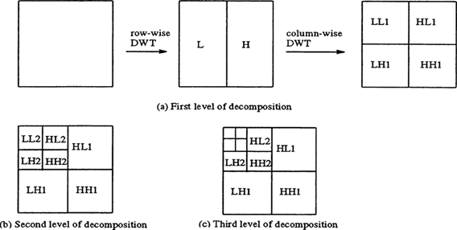
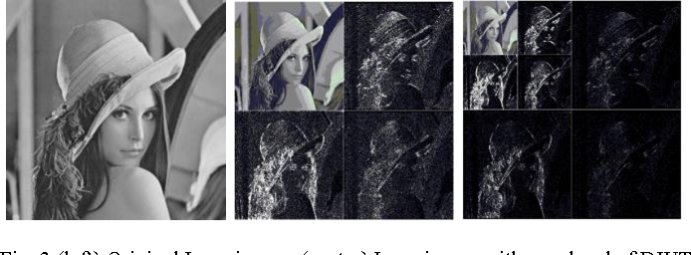
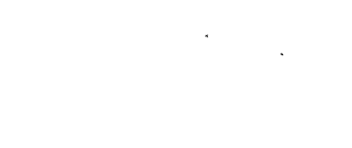
DWT-Process:
Aditya Engineering College(A)
Discrete Wavelet Transform(DWT) is a mathematical tool for hierarchically decomposing an image.
It decomposes a signal into a set of basis functions called wavelets.
If the shape of the signal matches with wavelet, then higher value of transform is obtained. If the signal is not matches with wavelet then low transform value is obtained.
Firstly the input image is filtered along rows and then it is followed by filtering sub image along column.
After Performing this Process it can offer the information in 4 ways as approximation(A), horizontal(H), vertical(V), and diagonal(D) coefficients.
By this process we can only considering only 1/4th sample of input image which is same as our input image.
Input image
LL1------Approximation coefficient
HL1------Horizontal coefficient
LH1------Vertical coefficient
HH1------Diagonal coefficient

Slide 5
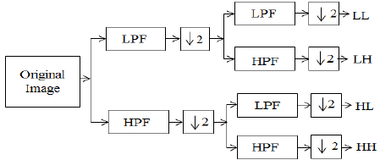
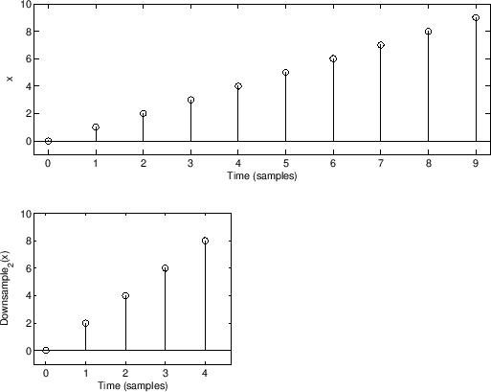
Aditya Engineering College(A)
The DWT decomposes the input sequence as low and high pass sub bands.
Each sub band consists of half samples of the original input.
In DWT the input is analyzed with analysis filter bank succeeded by the operation called decimation.
So here the input image is filtered along rows and decimated by two. Then it is followed by filtering sub image along column. This process separates the input into sub bands as LL,LH,HL,HH respectively.
Then perform the inverse discrete wavelet transform to the obtained image to get the fused image.
Down-Sampling:
The process of reducing the size of an image is called down sampling.
The down sampling factor is usually an integer or a rational fraction greater than unity.
Y[n]=x[D*n]
Where n =0,1,2,3…………

Slide 6
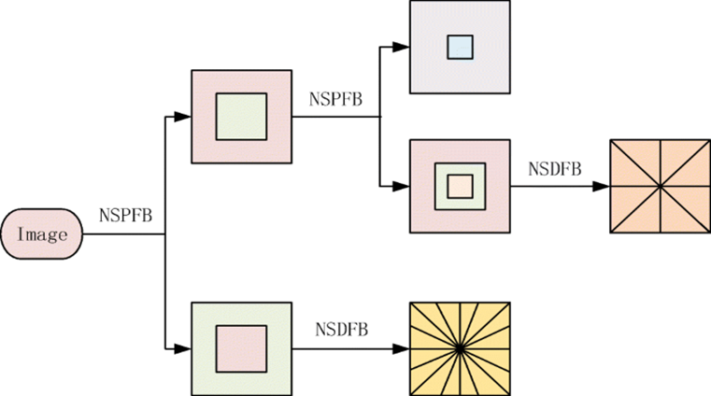
NSCT(Non sub sampled counterlet transform):
Aditya Engineering College(A)
NSCT is a shift invariant, multi-scale and multi-directional transform.
Provides accurate analysis of multimodality images.
It is obtained by using the Non-subsampled Pyramid Filter Bank (NSP or NSPFB) and the Non-subsampled Directional Filter Bank (NSDFB).
The source images are registered and decomposed into low and high freq. coefficients.
The low frequency coefficients fused and apply the avg. fusion rule and high frequency coefficients fused and apply max fusion rule.
In each sub-band transform coefficients is same as the original image.
Here quality is increased and provides better frequency selectivity.
NSPFB used to divide images into low and high frequency components.
NSDFB used to decompose high frequencies in each level of NSP.
At each decomposition level of NSP, one low-frequency image and one high-frequency image can be produced.

Slide 7
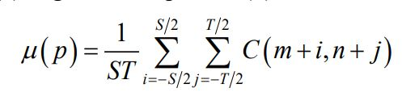
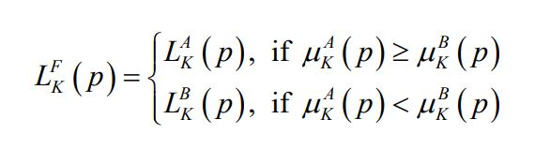
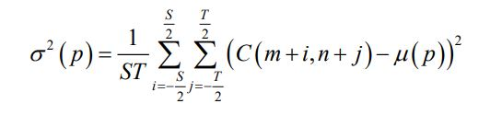

Procedure:
Aditya Engineering College(A)
Step1:The input images to be fused must be registered to assure that the corresponding pixels are aligned.
Step2:Decompose the images using NSCT to get low and high frequency sub bands.
Step3Fusion of low frequency symbols) : The coefficients of low frequency sub band of NSCT are selected by Equation (1) and Equation (2).
Mean(μ):
Eq1
Eq2
Eq3
Eq4
Step4(Fusion of high frequency symbols) : The coefficients of high frequency sub bands of NSCT are selected by Equation (3) and Equation (4).
Variance:
Step5:Perform the Inverse NSCT (INSCT) with the combined coefficients obtained from steps 3 and 4.

Slide 8
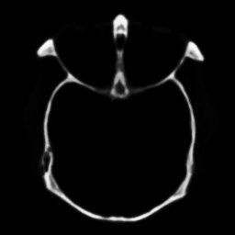
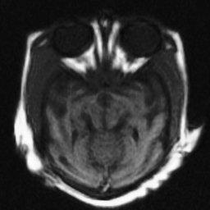
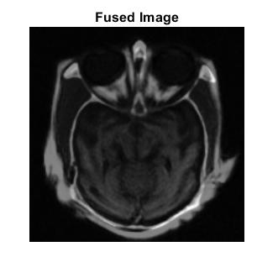
Aditya Engineering College(A)
CT SCAN
MRI SCAN
ENTROPY=5.988268​
PSNR1=31.753433​
PSNR2=37.984253​
Standard Deviation=0.126633

Slide 9
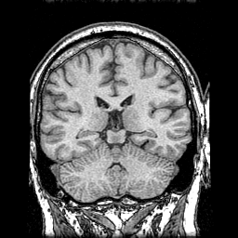
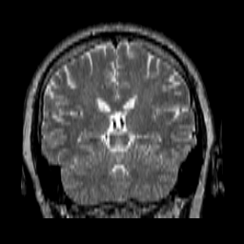
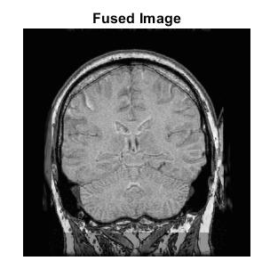
Aditya Engineering College(A)
MRI T1 SCAN
MRI T2 SCAN
ENTROPY=5.737619
PSNR1=41.385594
PSNR2=36.881347
Standard Deviation=0.187433

Slide 10
Aditya Engineering College(A)
Conclusion: The proposed fusion system for multimodality medical images using the NSCT— DWT method gives better results. This method enhances the image quality with short processing time and the fused image to give much more details for better disease analysis. The NSCT-DWT has shown good results for the multimodality images. The proposed technique is superior for visual quality, precise analysis and accurate localization of the disease. From the performance measures the proposed algorithm yields better results and it can be applied in real time clinical applications. The comparison on the basis of various performance metrics, it also has been concluded that proposed work performs effectively over existing DWT and NSCT algorithms.

Slide 11


Aditya Engineering College(A)

